Slide 1


Zeal Education Society's ZEAL COLLEGE OF ENGINEERING & RESEARCH Pune
Department of Artificial Intelligence & Data Science
BE Project
Applications Of Blockchain For Secure Bank Transactions
Guided By. - Prof. Anuja Garande
Presented by-
Shivam Patil
Gaurang Mhatre
Prathmesh Phadtre
Pratik Aher
t
.

Slide 2
Secure Banking Transactions
Based On Blockchain Technology

Slide 3
To overcome the drawbacks of conventional financial systems, like lack of transparency, higher security risks because of centralized servers, delays in fund settlements due to complex internal processes, also the issue of higher transaction costs due to a global customer base.
Problem Statement

Slide 4
PROJECT SCOPE
In order to over come weaknesses and inconvenience of online banking security, our proposed authentication system is designed to provide greater security and convenience by using user & transaction verification, authentication server & authorization.
To address existing security problem , the implementation of a trusted framework for online banking in public cloud using multi-factor authentication using Blockchain framework.
To design and develop an own custom blockchain to store all transaction record in secure manner.
Deploy a dynamic smart contract with consensus algorithm to enhance the transaction clarity to end user.

Slide 5
ABSTRACT
In the era of digital economy, everyone is forced to convert to a digital transaction and payment modes.
Though it has many merits to list, there is a critical element called security which is significant concern for both the service provider and the end-user.
Hence this project provides a holistic understanding of the application of blockchain technology in banking sector.
In this project we will discuss the meaning , steps, types, and application of blockchain technology in banking sector.
Proposed system proposes blockchain technology and its role in ensuring secured banking transactions.

Slide 6
Distributed Ledger Technology (DLT)
Distributed Ledger Technology (DLT) is the infrastructure enabling simultaneous access, validation, and record updating in a networked database.
Transparency: Allows users to view changes in the ledger and identifies the entities responsible.
Data reliability: Ensures the reliability of data stored on the distributed ledger.
Access control: Provides access only to authorized users, enhancing security.
Basis for blockchains: DLT forms the foundation for creating blockchain systems.

Slide 7
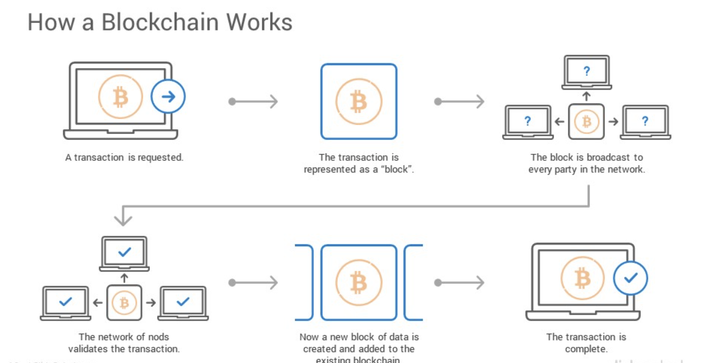

Slide 8
Need
Core Role: Consensus algorithm is pivotal for achieving agreement, trust, and security in a decentralized blockchain network.
Preventing 51% Attack: Designed to thwart the risk of a 51% attack, ensuring no single validator gains control over the network.
Decentralization Assurance: Ensures fair decision-making among network participants, preventing central

Slide 9
LITERATURE SURVEY
SURVEY | AUTHOR | YEAR | EXPLANATION
Blockchain application and outlook in the banking industry | Ye Guo and Chen Liang | 2016 | In this paper, Ye Guo and Chen Liang had presented their idea by examining the Chinese Banking sector. They said that Blockchains could revolutionize the underlying technology of the payment clearing and credit information systems in banks, thus upgrading and transforming them..
Blockchain Technology and the Financial Services Market, | Krause, et al | 2017 | The technology could remove trusted third parties, decrease costs and ultimately increase profits for various players within the industry. Although public blockchains provide high data security and transparency, they are relatively slow if a high number of transactions need to be processed. In the field of payment transactions, it could reshape the current correspondent banking processes and lead to cost savings.

Slide 10
BlockChain & Financial Inclusion | Prof.Reena Aggrawal | 2017 | A world bank report, 2014 said that around 2 billion individuals who don't have access to banking services. From which 20.6% of unbanked individuals are from India. This paper discussed that blockchain can play a significant role in the financial Inclusion process. It says that F.I. using blockchain for internal and cross-border payments can lower costs, shorten settlement time, and provide a better user experience
Blockchain in banking | Deloitte | 2017 | As transactions are being done up on Blockchain, Blockchain DLT and all the relevant parties can view and verify the processes. There is only one source of truth and transactions cannot be processed further unless all the relevant parties agree and authenticate it.

Slide 11
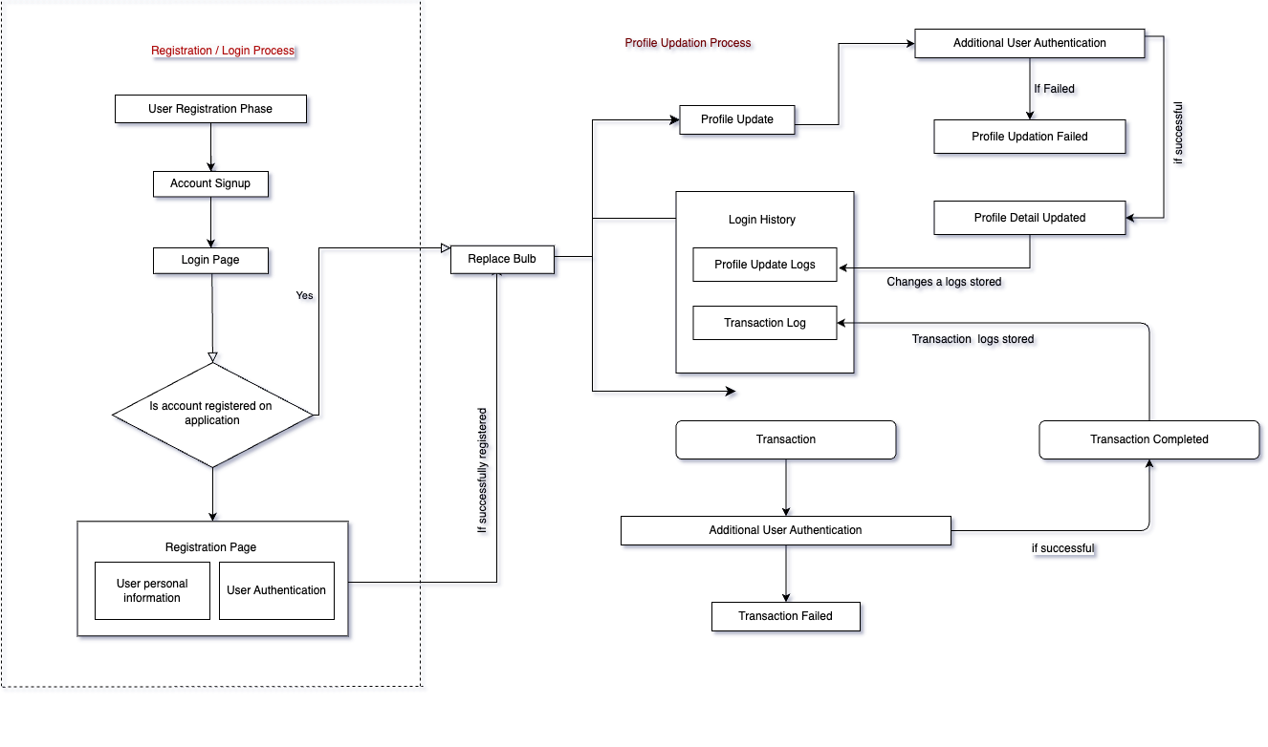
Architectural Design :

Slide 12
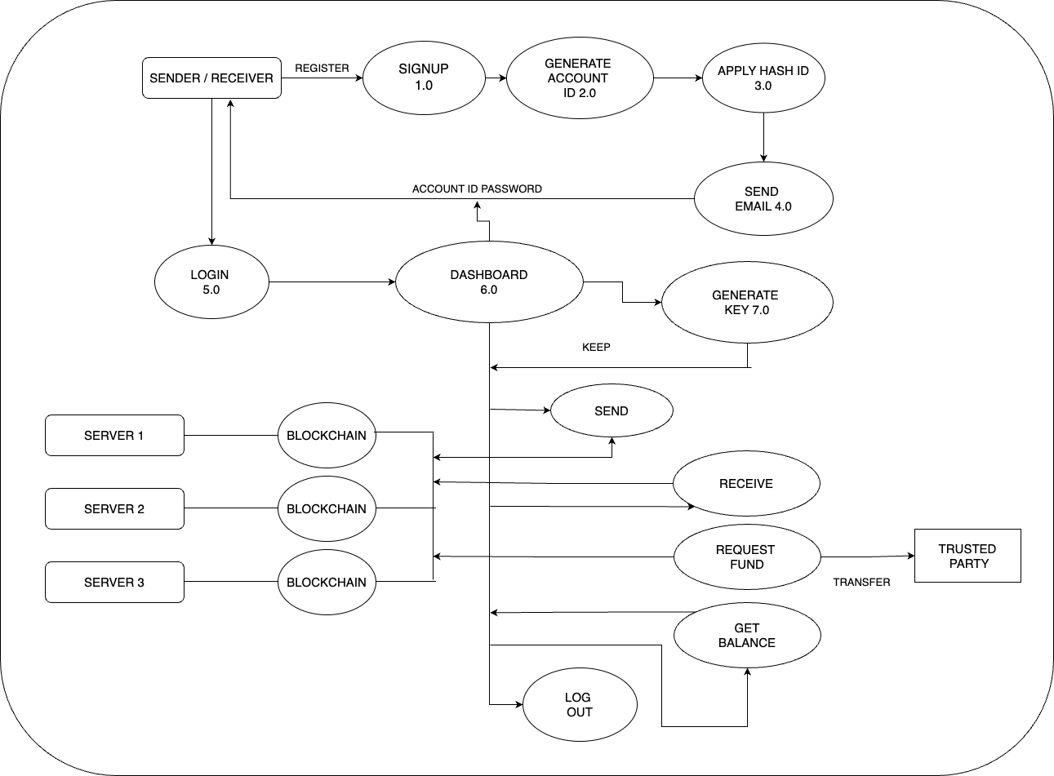
Data Flow Diagram

Slide 13
Consensus Algorithm
Consensus algorithm: Mechanism in decentralized networks for agreement on activities.
Purpose: Ensure secure, reliable, and trustworthy transactions among network peers.
Blockchain role
Security
Immutability
Trust establishment

Slide 14
Consensus Algorithms:
Proof of Work (PoW)
Proof of Stake (PoS)
Delegated Proof Of Stake (DPoS)
Practical Byzantine Fault Tolerance (PBFT)
Proof of Burn (PoB)
Proof of Capacity

Slide 15
Proof of Stake (Pos)
01
Stake is value / money / cryptocurrency. In this user has to bet certain outcome.
Stakes are amount of cryptocurrency to become a validator or miner.
02
02
Node made transaction and it is put in transaction pool.
All nodes contending to become validator put some currencies at stake.
03
A random validator is selected based on amount of currency and coin of age.
Once validator passes the block , send to network to be verified.
04
Once its verified , block gets added to network , miner gets rewarded. (Gas Fee) .
His coin age reset to 0.
05
Example – Ethereum
Energy Efficient & Decentralization .

Slide 16
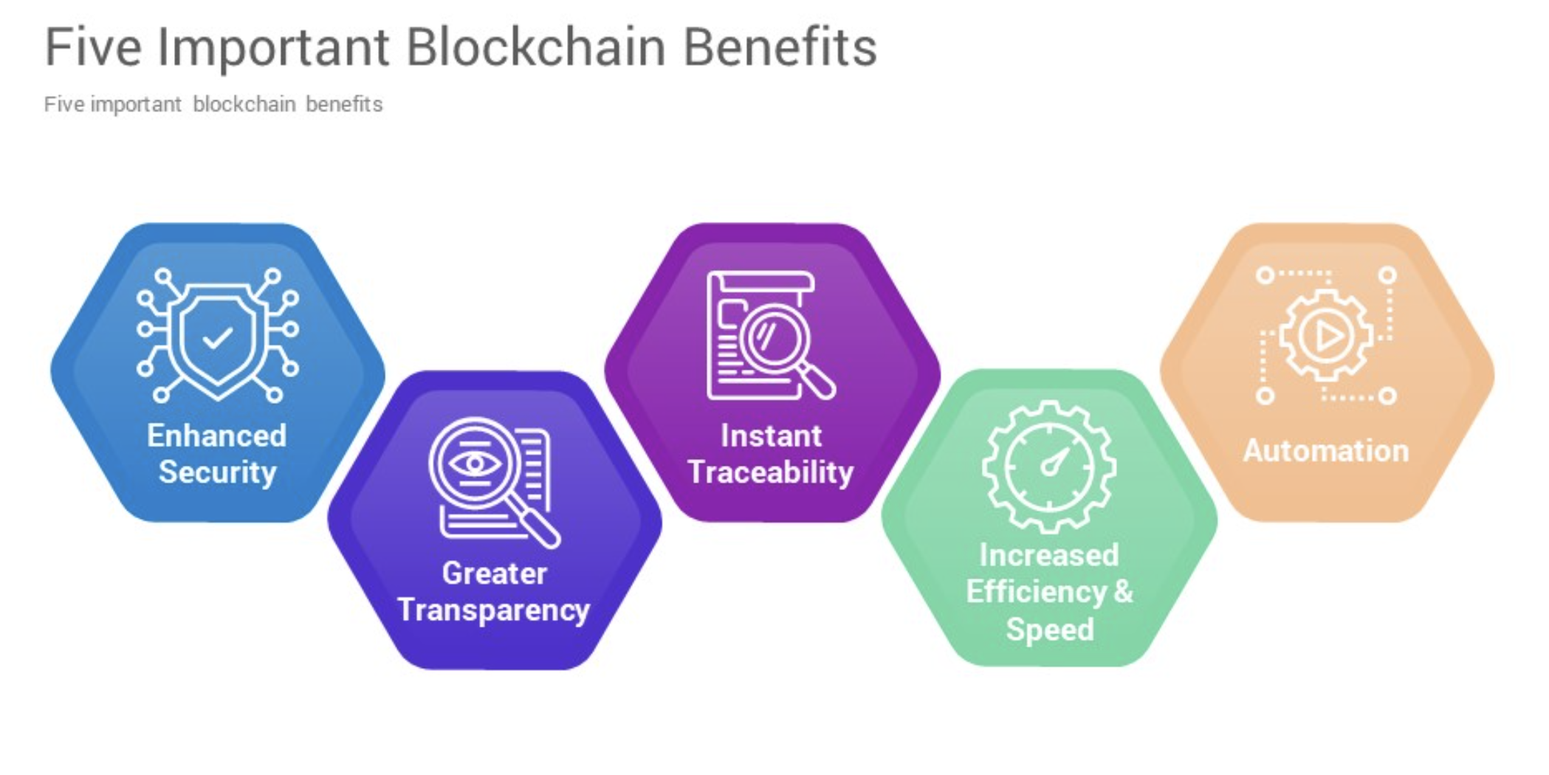

Slide 17
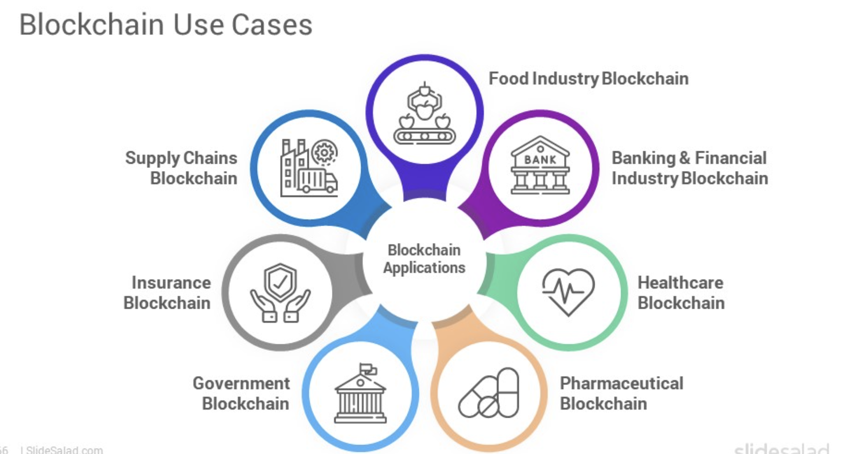

Slide 18
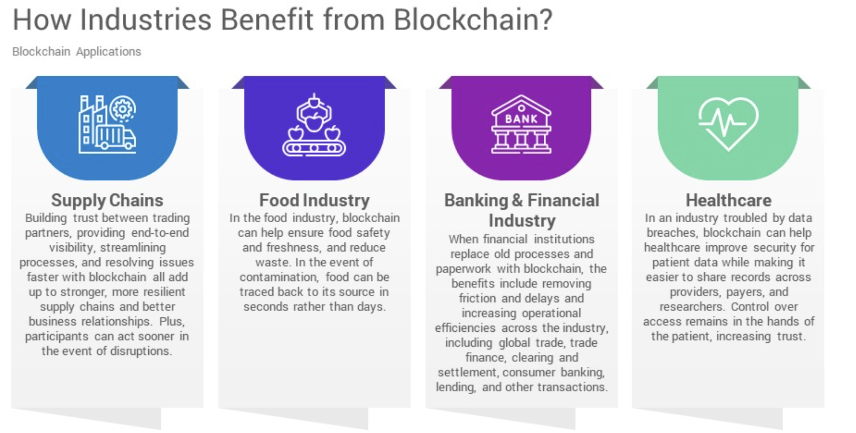

Slide 19
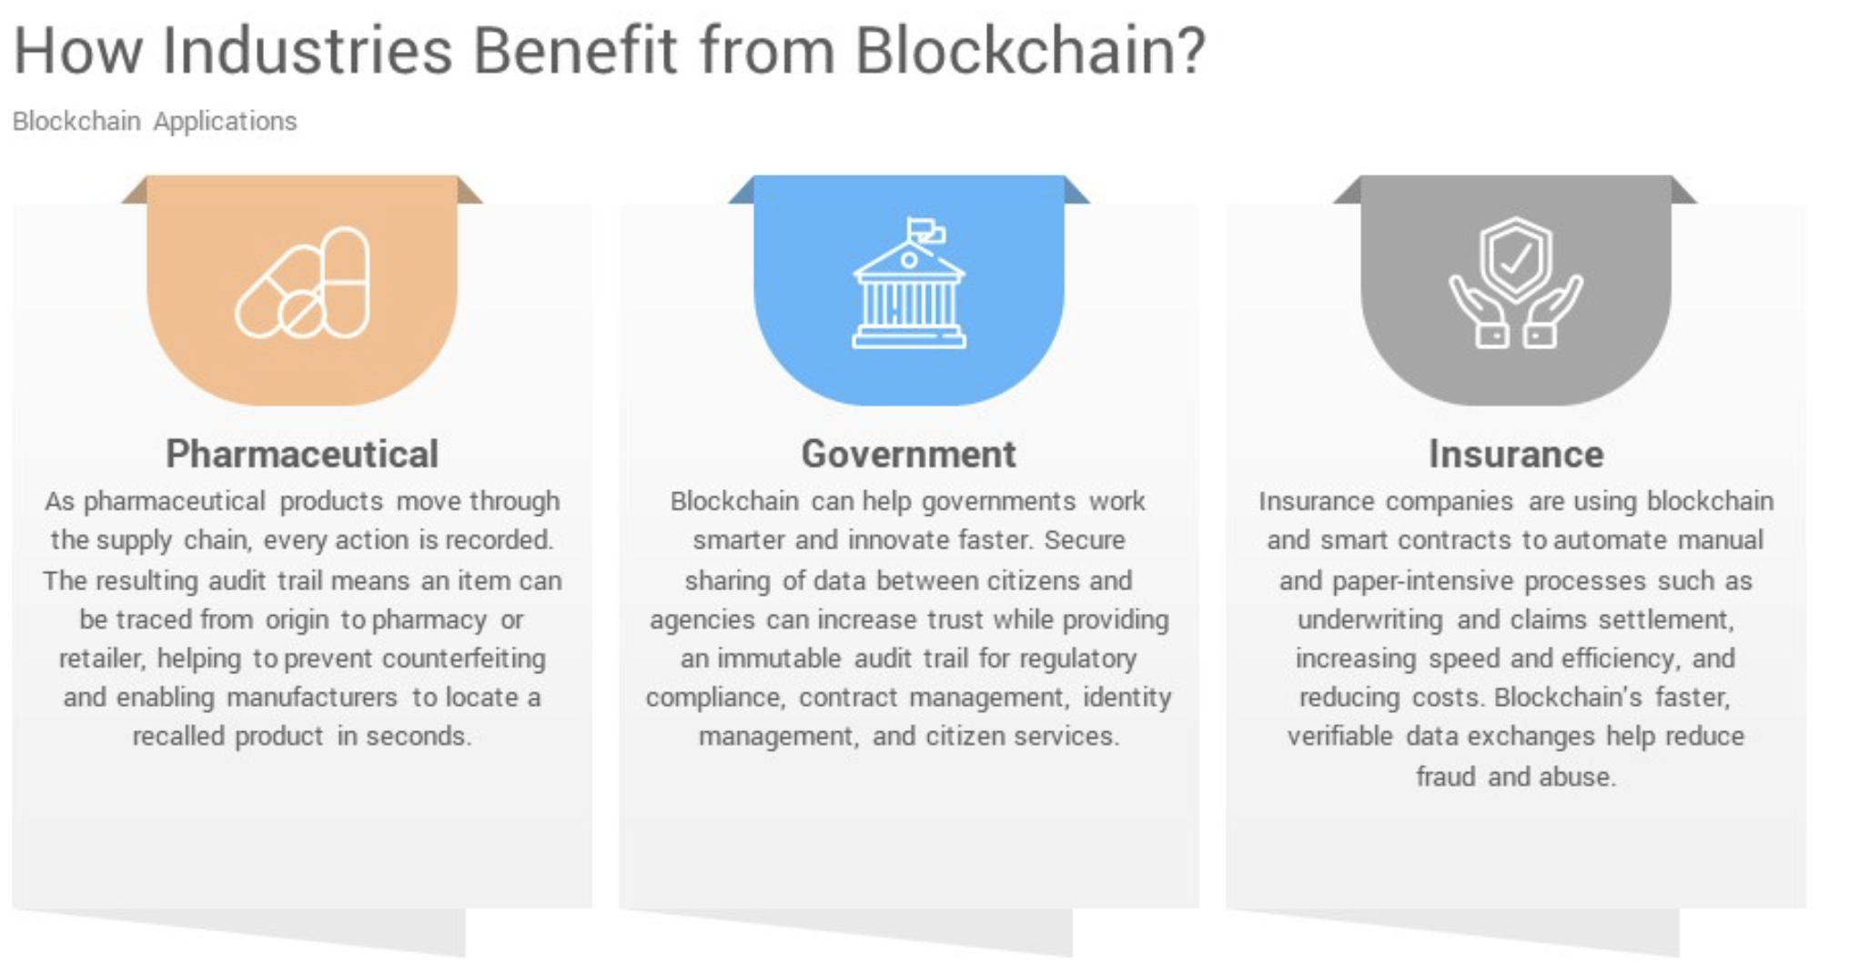

Slide 20
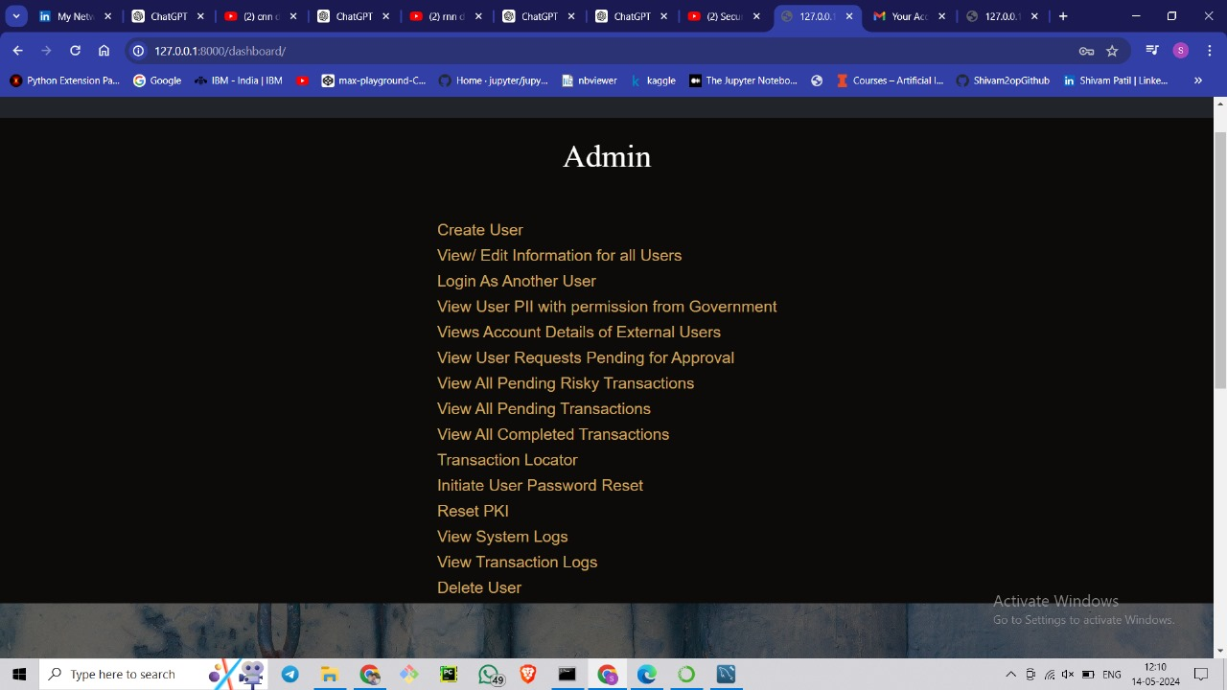
Outputs

Slide 21
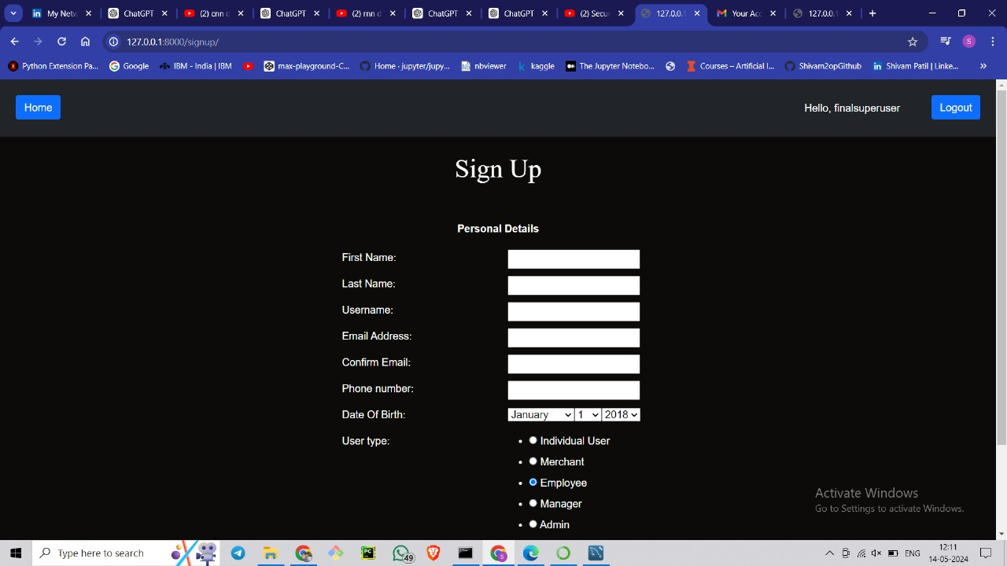

Slide 22
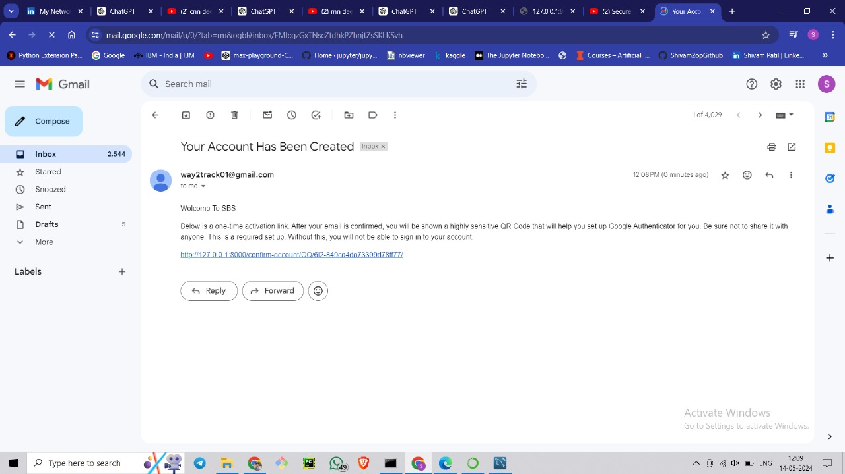

Slide 23
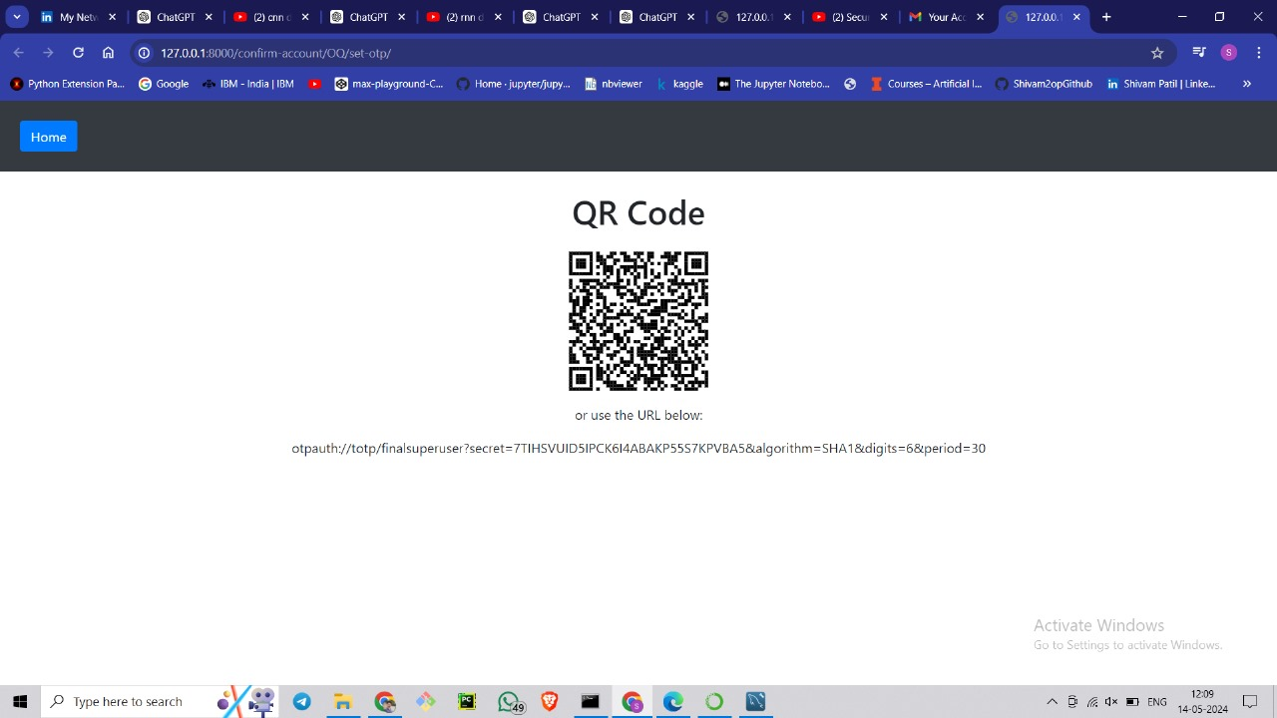

Slide 24
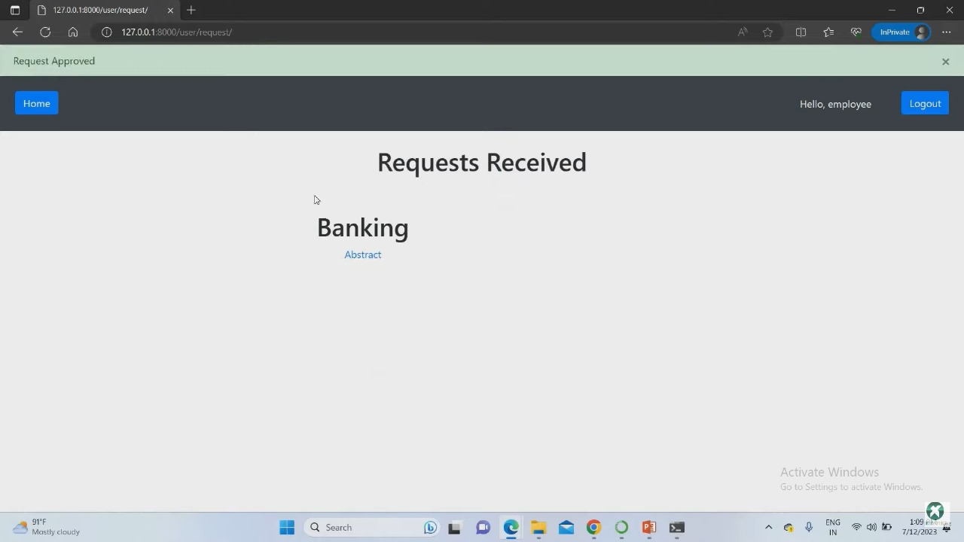

Slide 25
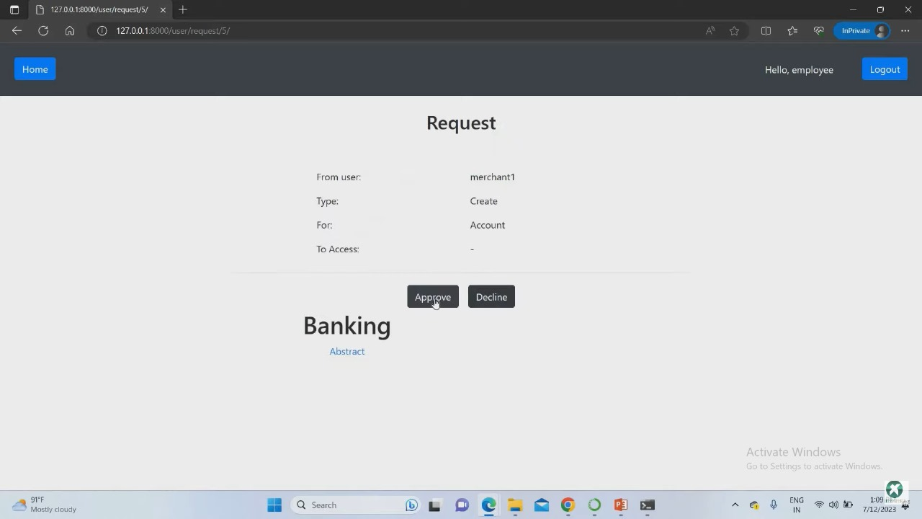

Slide 26
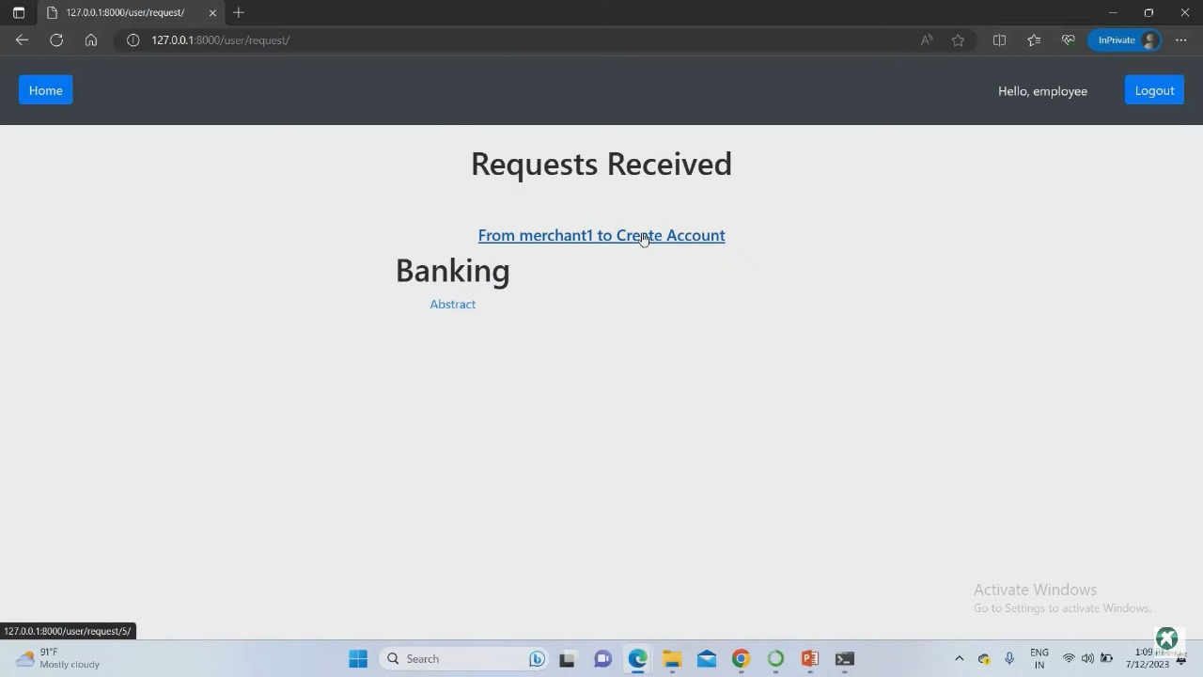

Slide 27
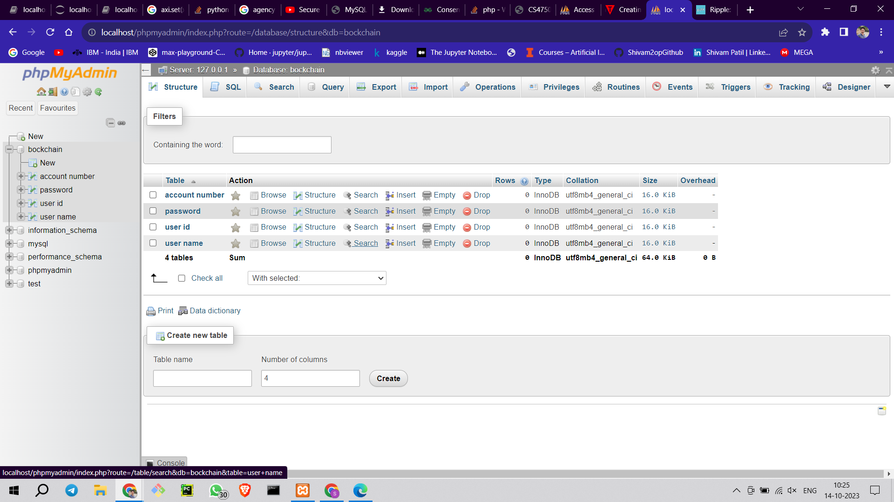

Slide 28
BIBLIOGRAPHY
[Blockchain application and outlook in the banking industry, Ye Guo and Chen Liang, 2016
Blockchain Technology and the Financial Services Market, Krause et al., 2017
BlockChain & Financial Inclusion,Prof. Reena Aggrawal, 2017
Blockchain in banking, Deloitte, 2017
Block Chain Technology its use in Banking Sector-S Ravi - BW Businessworld

Slide 29
Conclusion
Key Takeways
01
Blockchain technology is a standout amongst the most predictable advances when it requires monitoring money related properties.
02
Blockchain innovation has pulled in numerous organizations that need to include the particular highlights of it to their security structures.
03
The legislature is watching Blockchain as an approach to investigate a scope of alternatives which may apply a filter control on the country's economy.

Slide 30
Thank You

